Slide 1
Safer Conception Services: A model to support progress towards 909090 goals for men and women with horizontal and vertical HIV transmission risks
TUPDC01
N. Davies¹, S. Mullick¹, N. Naidoo¹, S. Schwartz^{1,2}
¹Wits Reproductive Health and HIV Institute (Wits RHI), Johannesburg, South Africa
²Johns Hopkins Bloomberg School of Public Health, Baltimore, United States
“Must do better: addressing the failures of SRH HIV integration”
23 July 2019

Slide 2
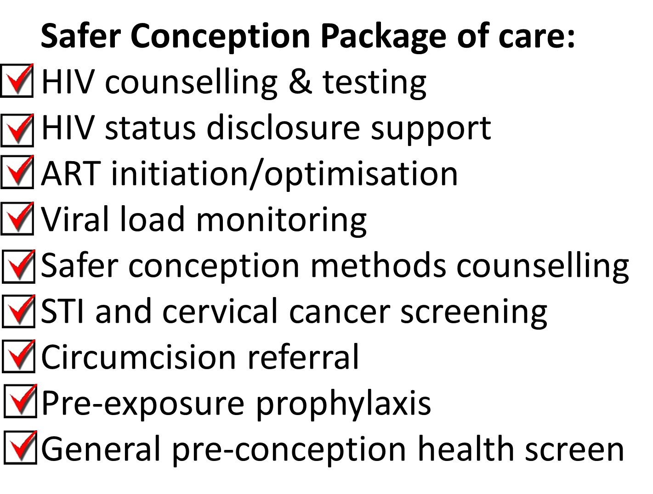
Overview: Safer Conception Project
Goal
Minimise horizontal and vertical HIV transmission risks for HIV-affected people during
peri-conception

Slide 3
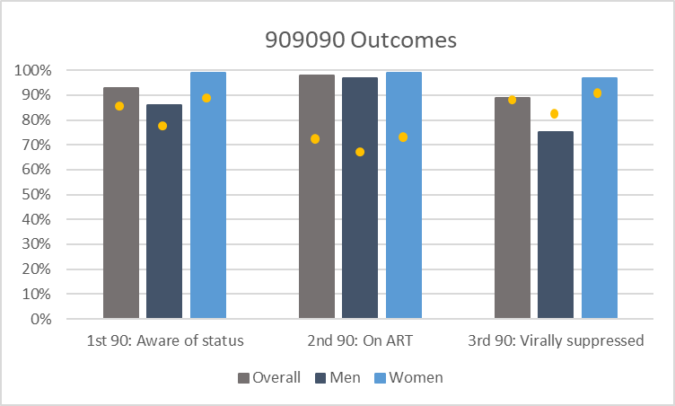
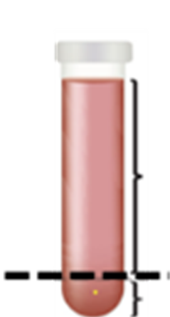
Outcomes (n = 692, 454 Females, 238 males)
10% testing yield amongst partners
85% linkage to ART
70% of unsuppressed clients became suppressed
68/71 HIV-exposed babies confirmed HIV PCR negative (3 untraceable)
909090 results from the 5th SA national HIV prevalence, incidence, behaviour and communication survey, 2017
reported or observed

Slide 4
Conclusions
HIV care & treatment
Men
Safer conception services
909090
HIV prevention
Women
EMTCT
Sexual & reproductive health
If you are interested in safer conception service implementation,
check out our free implementation guide and clinical tools at:
http://bit.ly/2lnt9cM
Rare opportunity for SRH/HIV integration for men and women.
Wider safer conception services implementation is needed

